Slide 1
AZ-300T01 M 2: Implementing and Managing Storage
Azure Storage Accounts
Data Replication
Azure Storage Explorer
Storing and Accessing Data
Monitoring Storage

Slide 2
Azure Storage
Azure Storage serves as:
Storage for Azure VMs:
operating system and data disks
file storage
Store for unstructured data:
Blobs
Queues
Data Lake Store
Store for structured data:
Tables
Cosmos DB
Azure SQL Database

Slide 3
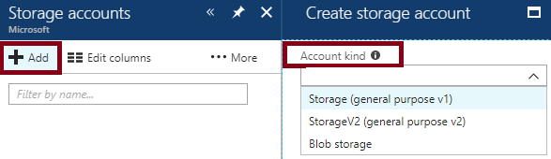
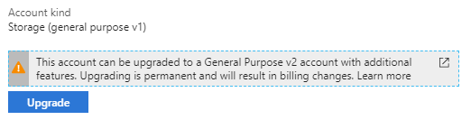
Azure Storage Accounts
Storage (general purpose v1):
Can contain blobs (including Azure VM disks), tables, queues, files
Supports performance tiers: Standard and Premium
Blob storage:
Can contain blobs only
Supports access tiers: hot, cool, archive
Storage V2 (general purpose v2):
Can contain blobs (including Azure VM disks), tables, queues, files
Supports performance tiers: Standard and Premium
Supports access tiers: hot, cool, archive
Support upgrade from:
Blob storage
Storage (general purpose v1)

Slide 4

Standard and Premium Storage Accounts
Performance tiers:
Standard:
Best for workloads that do not require high performance I/O
Offer the lowest cost per GB
Backed by magnetic drives (HDD)
Premium (available exclusively for provisioning Azure VM disks):
Best for I/O-intensive workloads, such as databases.
Offer consistent low-latency, high throughput/IOPS
Backed by solid state drives (SSD)

Slide 5
Storage Account Endpoints
Blob service: http://mystorageaccount.blob.core.windows.net
Table service: http://mystorageaccount.table.core.windows.net
Queue service: http://mystorageaccount.queue.core.windows.net
File service: http://mystorageaccount.file.core.windows.net

Slide 6
Configuring Custom Domain Names
Direct CNAME mapping:
Create a CNAME record that points to the Azure storage account [storage account].blob.core.windows.net.
This method can result in a brief downtime during registration of the custom domain with Azure.
Intermediary mapping with asverify:
Step 1. Prepend asverify to your own CNAME record. This allows Azure to recognize your custom domain.
Step 2. Modify the DNS record for the domain.
This methods eliminates downtime.

Slide 7
Pricing and Billing
Storage costs depend on:
The amount of data
Performance level
Access tier (per-gigabyte cost decreases as the tier gets cooler)
Storage costs include:
Data access costs: increase as the tier gets cooler.
Transaction costs: increases as the tier gets cooler.
Geo-Replication data transfer costs (per GB): for GRS and RA-GRS storage accounts.
Outbound data transfer costs (per GB): transferred out of an Azure region
Changing the storage tier:
Changing the account storage tier from cool to hot incurs a charge equal to reading all the data existing in the storage account.
changing the account storage tier from hot to cool incurs a charge equal to writing all the data into the cool tier (GPv2 accounts only).

Slide 8
Demonstration: Creating Storage Accounts

Slide 9
Practice: Storage Account Management
Let’s create a Storage Account

Slide 10
Lesson 2: Data Replication
Replication Options
Locally Redundant Storage
Geo-Redundant Storage
Zone Redundant Storage
Replication Option Comparison
Storage Account PowerShell Tasks

Slide 11
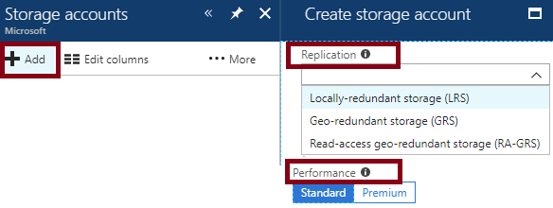
Replication Options
Locally-redundant storage (LRS):
The only replication option when using Premium performance tier
Zone-redundant storage (ZRS):
Geo-redundant storage (GRS)
Read-access geo-redundant storage (RA-RGS)

Slide 12
Locally Redundant Storage
Copies:
3 in the same Azure facility
Strategy:
Data replicated synchronously across 3 replicas in the same Azure facility
Protection:
Localized hardware failures
Additional considerations:
LRS is an economical option if your data can be easily reconstructed
LRS is the only available option if you use the Premium performance tier
When using LRS, you should plan for an alternative recovery strategy

Slide 13
Geo-Redundant Storage
Copies:
Total of 6, with 3 per Azure region.
Strategy:
Data replicated synchronously across 3 replicas in the same Azure facility
Data replicated synchronously within each region and asynchronously across regions.
Protection:
Localized hardware failures and region-wide disasters
Additional considerations:
With GRS, data in the secondary region becomes available for reads and writes (via the primary endpoint) only after Microsoft initiates a failover from the primary region.
With RA-GRS, data in the secondary region is always available for reads (via the secondary endpoint). It becomes available for writes (via the primary endpoint) only after Microsoft initiates a failover from the primary region.

Slide 14
Zone Redundant Storage
Copies:
3 across different Azure facilities in separate zones in the same region.
Strategy:
Data replicated synchronously across 3 replicas in separate zones in the same region.
Protection:
Localized hardware failures and failures of individual facilities
Additional considerations:
ZRS is not yet available in all regions.
ZRS may not protect your data against a regional disaster where multiple zones are permanently affected.
ZRS does not support Azure VM disk files

Slide 15
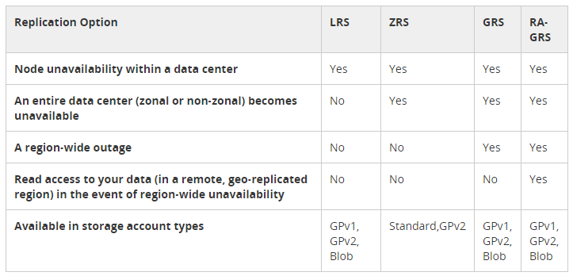
Replication Option Comparison

Slide 16
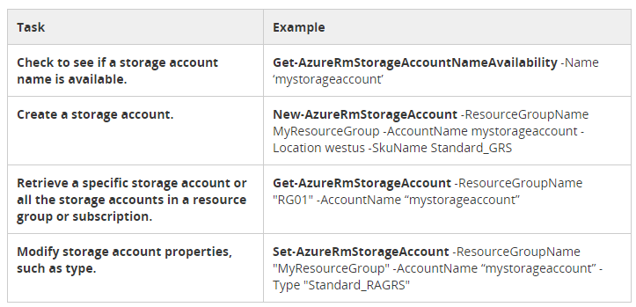
Storage Account PowerShell Tasks

Slide 17
Lesson 3: Azure Storage Explorer
Azure Storage Explorer
Storage Explorer Functionality
Video: Overview of Azure Storage Explorer
Video: Keyword Search in Azure Storage Explorer
Video: Storage Explorer Table Query
Demonstration: Storage Access Tools
Practice: Storage Explorer

Slide 18
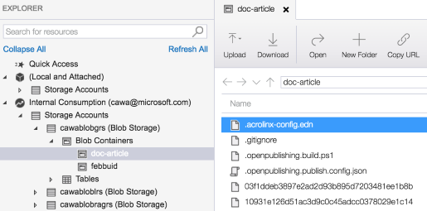
Azure Storage Explorer
An open-source Microsoft app for managing Azure storage, including:
Viewing and editing Blob, Queue, Table, File, Cosmos DB storage and Data Lake Storage.
Creating, deleting, viewing, and editing storage objects.
Generating shared access signature (SAS) keys.
Accessing multiple subscriptions.
Available for:
Windows
macOS
Linux

Slide 19
Storage Explorer Functionality
Connect to an Azure subscription:
Manage storage resources that belong to your Azure subscription.
Manage storage resources that belong to another Azure subscription
Manage storage resources in national Azure clouds
Work with local development storage:
Manage local storage by using the Azure Storage Emulator.
Connect to storage accounts by using the storage account's name and key.
Connect to storage resources by using a shared access signature (SAS).
Connect to a specific storage service (blob container, queue, or table) by using a SAS.
Connect to an Azure Cosmos DB account by using a connection string.

Slide 20
Video: Overview of Azure Storage Explorer

Slide 21
Video: Keyword Search in Azure Storage Explorer

Slide 22
Video: Storage Explorer Table Query

Slide 23
Demonstration: Storage Access Tools

Slide 24
Practice: Storage Explorer
Let’s work with storage explorer

Slide 25
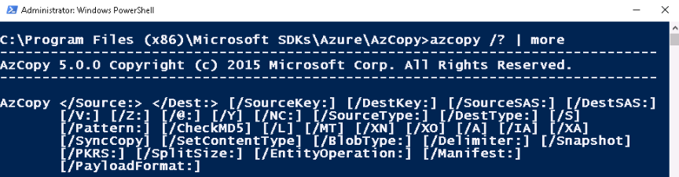
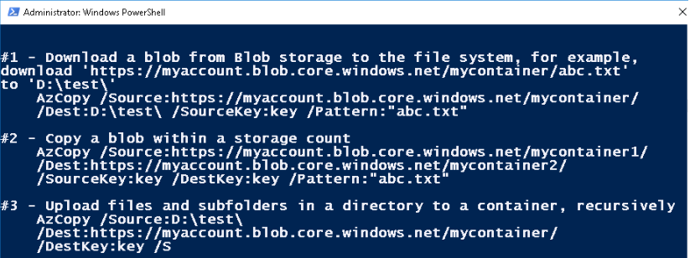
AzCopy
a command-line utility for automating Azure Storage tasks:
Copy to/from Microsoft Azure Blob, File, and Table storage
Copy between a file system and a storage account, or between storage accounts

Slide 26
Import and Export Service
Transfers very large amounts of data between on-premises and Azure:
Import. Securely transfers data to Azure Blob storage (block and page blobs) and Azure Files. You ship hard drives containing your data to an Azure data center.
Export. Securely transfers data from Azure Blob storage (block, page, and append blobs) to your location. You ship empty hard drives to an Azure data center.
Scenarios:
Migrating data to the cloud
Content distribution
Backup and data recovery

Slide 27
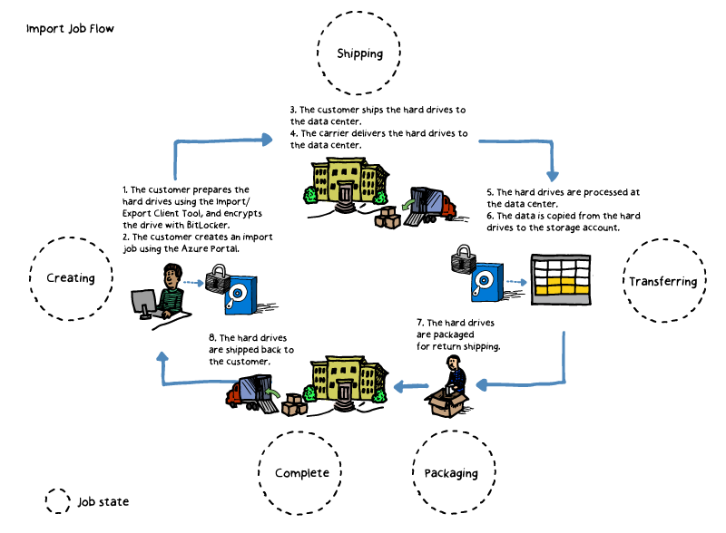
Import Jobs
Identify:
data to be imported
the number of drives
destination blob or file
Run WAImportExport Tool:
To copy data to hard disk drives
To encrypt data with BitLocker
Create an import job:
Via Azure portal (upload drive journal)
Via Import/Export REST API
Provide shipping info
Ship the hard disk drives
Update tracking number
Microsoft handles:
Job processing
Shipment of drives back to you

Slide 28
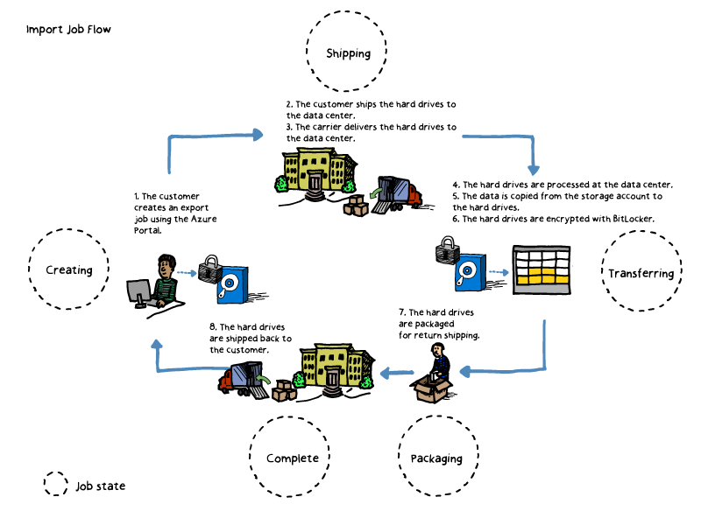
Export Jobs
Identify:
data to be exported
the number of drives
the source blobs
Create an export job:
via the Azure portal
via Import/Export REST API
Provide shipping info
Ship empty hard drives
Update delivery tracking info
Microsoft handles:
job processing
shipment of drives back to you

Slide 29
Lesson 4: Storing and Accessing Data
How CDN Works
CDN Profile
CDN Endpoints
CDN Time-to-Live
CDN Compression
Video: Using Azure CDN features in the Azure Portal
Video: Optimize Your Content Delivery with Azure CDN
Practice: Optimize Your Content Delivery with Azure CDN

Slide 30
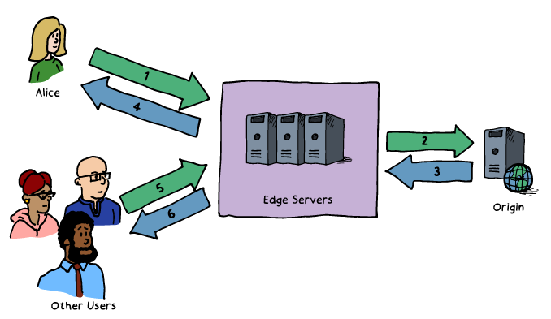
How CDN Works
Azure content caching service:
Designed to expedite delivery of audio, video, images, etc. hosted by Azure services
Utilizes the following data flow:
1. Alice requests a file using a URL pointing to a CDN location. DNS routes the request to the optimal POP
2. If edge servers do not have the file cached,
they requests it from the origin.
3. The origin returns the file, including its TTL.
4. The server caches the file and returns it to Alice.
The file remains cached until the TTL expires.
5. Subsequent requests are served from the cache.

Slide 31
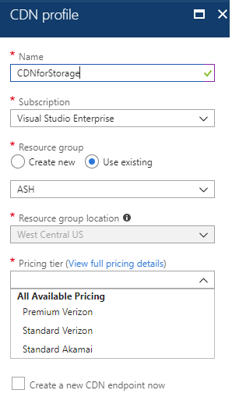
CDN Profile
A collection of CDN endpoints with the same:
Pricing tier and provider:
Premium Verizon
Standard Verizon
Standard Akamai
Pricing based on:
GBs of outbound data transfers
Zone:
Zone 1—North America, Europe, Middle East and Africa
Zone 2—Asia Pacific (including Japan)
Zone 3—South America
Zone 4—Australia
Zone 5—India

Slide 32
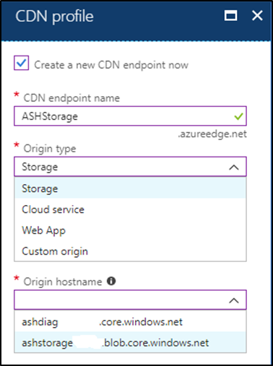
CDN Endpoints
Represent configuration of content origin:
CDN endpoint name
Origin type:
Storage
Cloud Service
Web App
Custom origin
Origin hostname
CDN features that affect content delivery, such as:
Compression
Query string
Geo filtering
Custom domains

Slide 33
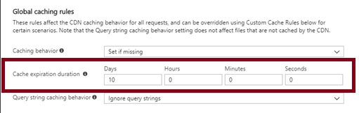
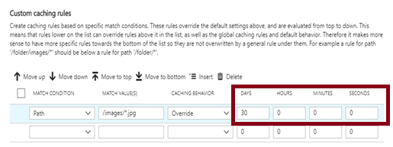
CDN Time-to-Live
CDN TTL can be:
Included in cache-directive headers in the HTTP response from the content origin
Determined by Cache Expiration Duration, configurable by using:
Global caching rules: affect all requests to the endpoint
Custom caching rules: match paths and file extensions
Custom caching rules override global ones

Slide 34
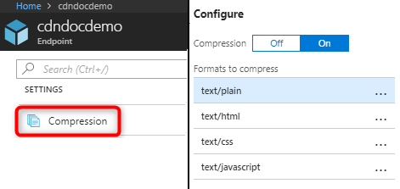
CDN Compression
Improves file transfer speed and increases page-load performance:
Supports:
Enabling compression on the origin. In this case, the CDN passes along the compressed files and delivers them to clients that request them.
Enabling compression directly on the CDN edge servers. In this case, the CDN compresses the files and serves them to end users.
Enabling compression based on the MIME types list, allowing selection of the content formats to compress.

Slide 35
Video: Using Azure CDN features in the Azure Portal

Slide 36
Video: Optimize Your Content Delivery with Azure CDN

Slide 37
Practice: Azure Import/Export Tool

Slide 38
Practice: Optimize Your Content Delivery with Azure CDN

